Slide 1
Classes and Objects

Slide 2
Create a Class
To create a class, use the class keyword:
Example
Create a class called "MyClass":
class MyClass { // The class
public: // Access specifier
int myNum; // Attribute (int variable)
string myString; // Attribute (string variable)
};

Slide 3
Create an Object
int main() { MyClass myObj;
// Create an object of MyClass // Access attributes and set values myObj.myNum = 15; myObj.myString = "Some text"; // Print attribute values cout << myObj.myNum << "\n"; cout << myObj.myString; return 0; }
class MyClass { public: int myNum; string myString; };

Slide 4
Multiple Objects
int main() { // Create an object of Car Car carObj1; carObj1.brand = "BMW"; carObj1.model = "X5"; carObj1.year = 1999; // Create another object of Car Car carObj2; carObj2.brand = "Ford"; carObj2.model = "Mustang"; carObj2.year = 1969; // Print attribute values cout << carObj1.brand << " " << carObj1.model << " " << carObj1.year << "\n"; cout << carObj2.brand << " " << carObj2.model << " " << carObj2.year << "\n"; return 0; }
class Car { public: string brand; string model; int year; };

Slide 5
Class Methods
Methods are functions that belongs to the class.
There are two ways to define functions that belongs to a class:
Inside class definition
Outside class definition

Slide 6
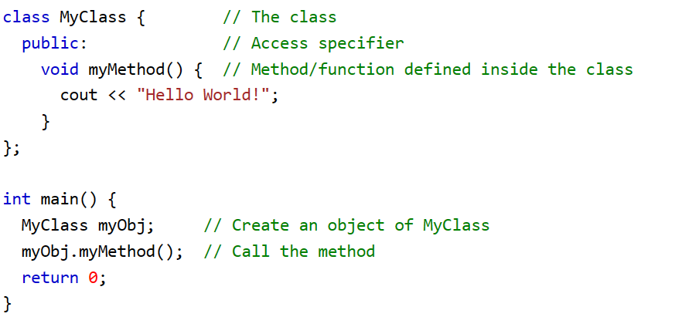

Slide 7
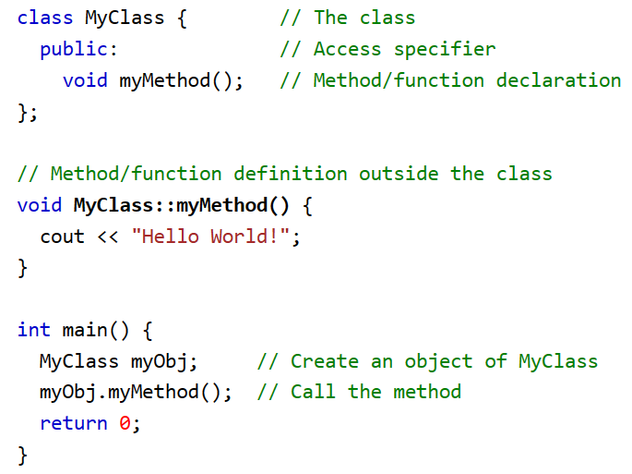

Slide 8
Constructors
A constructor in C++ is a special method that is automatically called when an object of a class is created.
To create a constructor, use the same name as the class, followed by parentheses ():

Slide 9
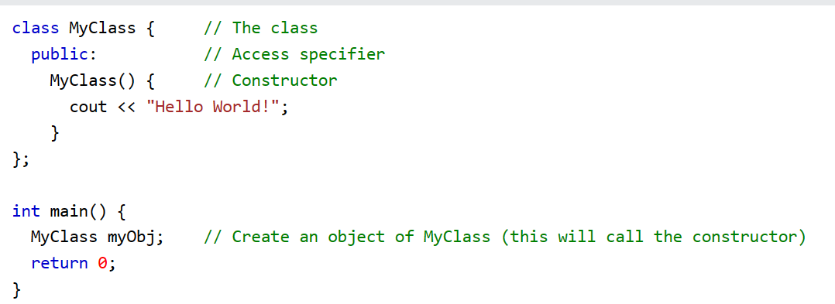

Slide 10
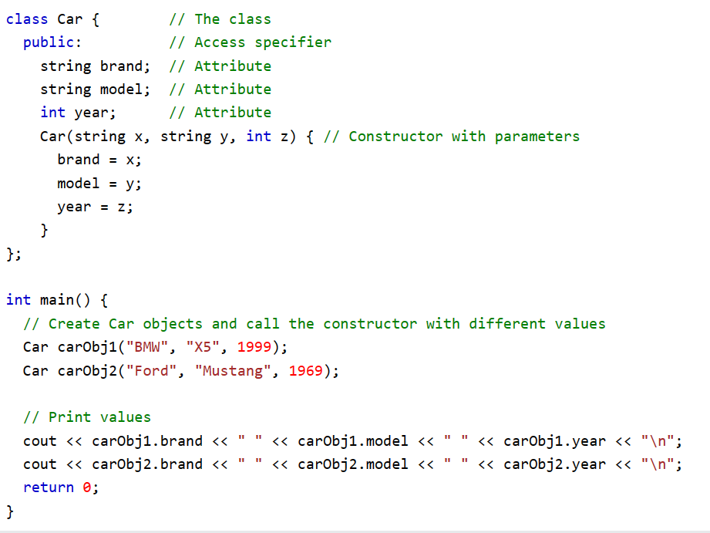

Slide 11
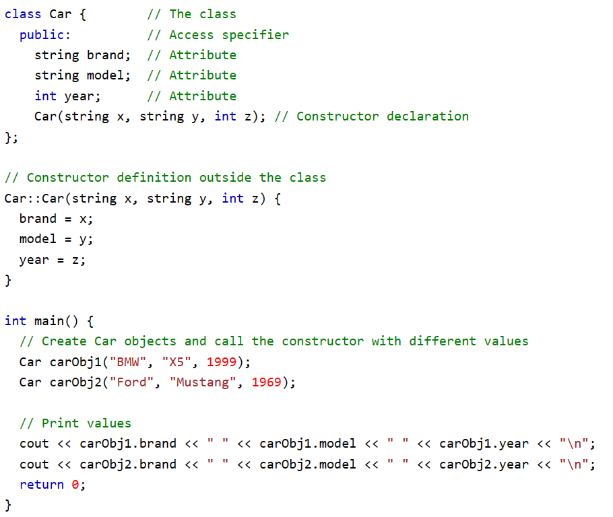

Slide 12
C++ Destructor
Destructors in C++ are members functions in a class that delete an object. They are called when the class object goes out of scope such as when the function ends, the program ends, a delete variable is called etc.

Slide 13
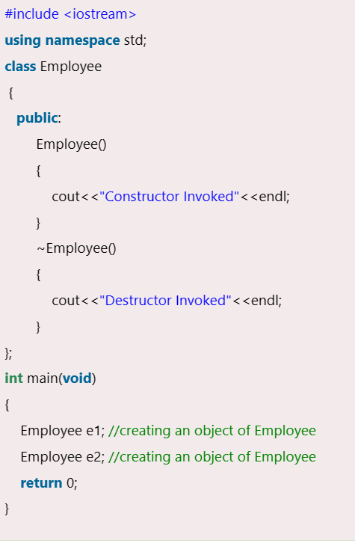

Slide 14
This Pointer
In C++ programming, this is a keyword that refers to the current instance of the class. There can be 3 main usage of this keyword in C++.
It can be used to pass current object as a parameter to another method.
It can be used to refer current class instance variable.
It can be used to declare indexers.

Slide 15
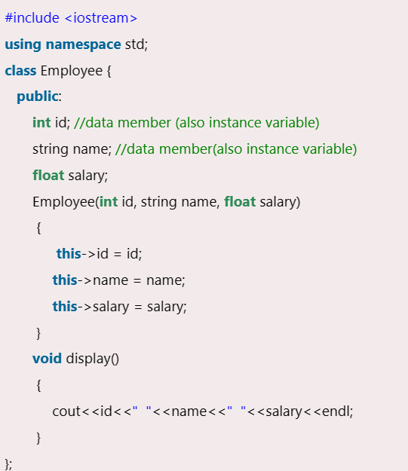
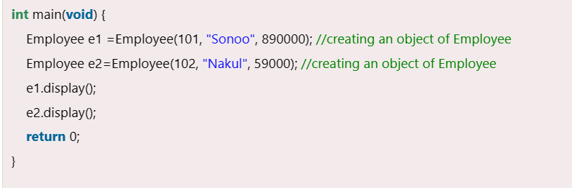

Slide 16
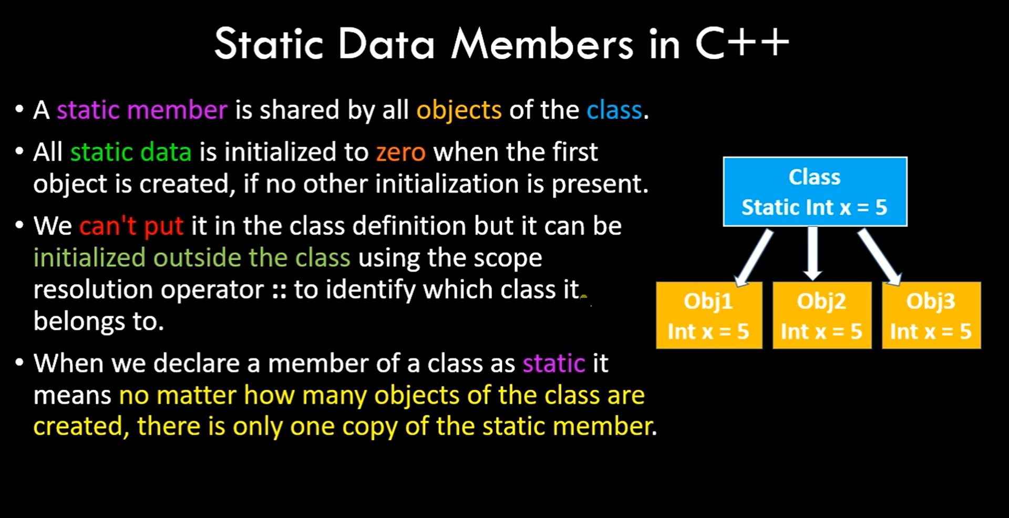

Slide 17
Static data member
Syntax
static data_type data_member;
Here, the static is a keyword of the predefined library.

Slide 18
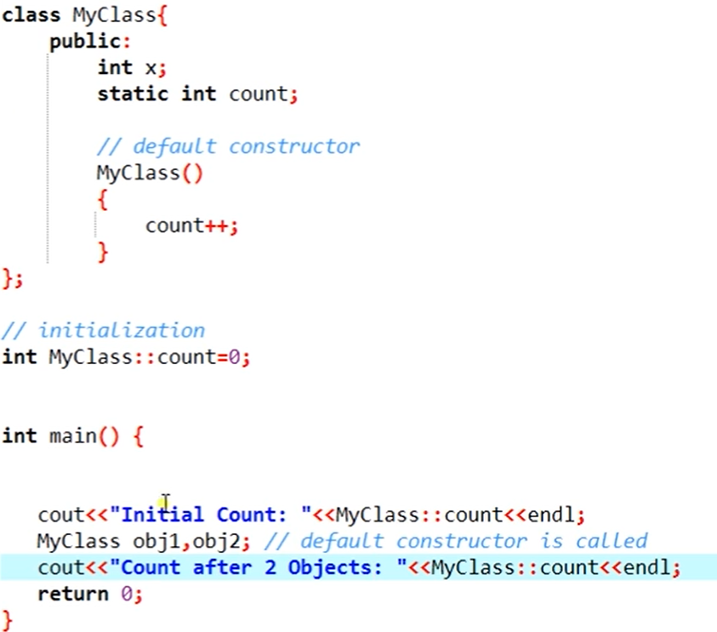

Slide 19
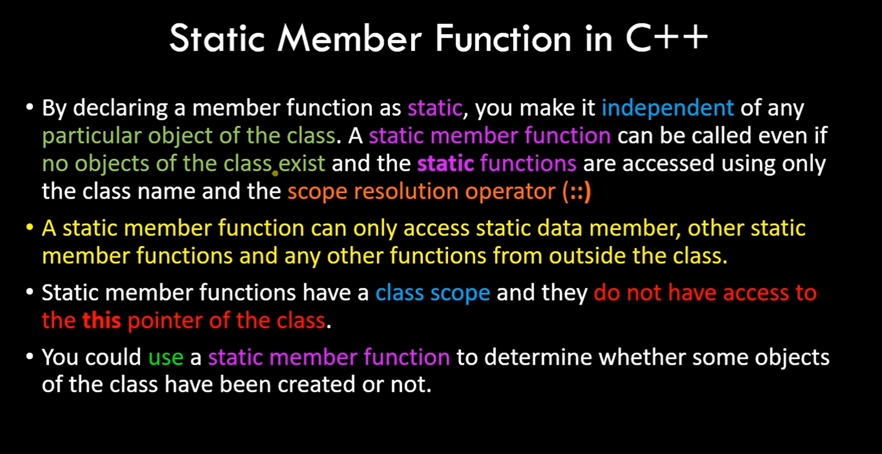

Slide 20
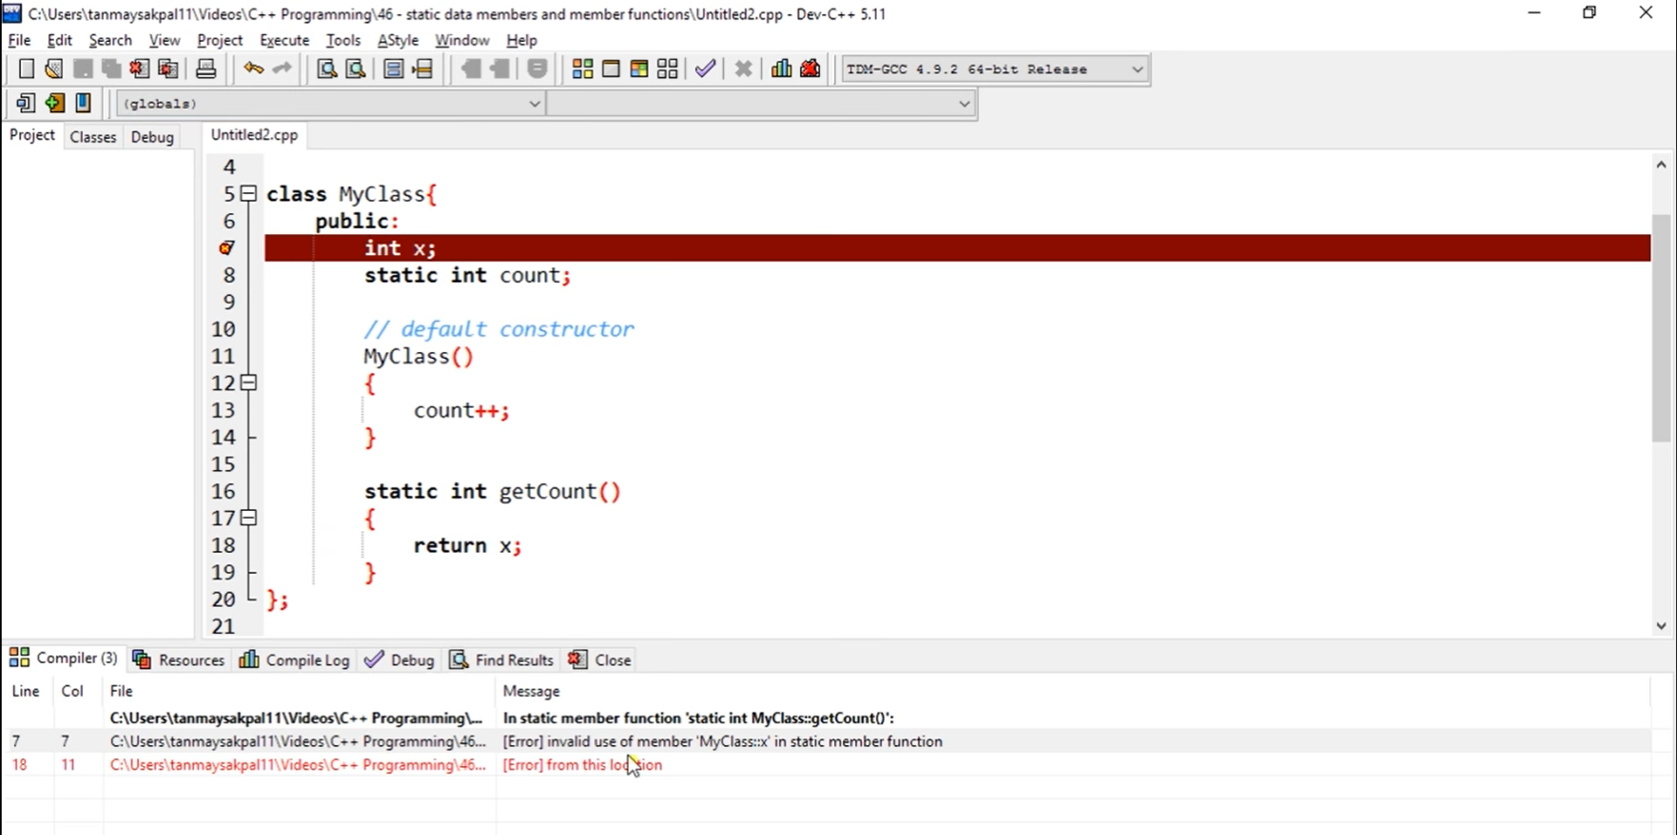

Slide 21
